Slide 1
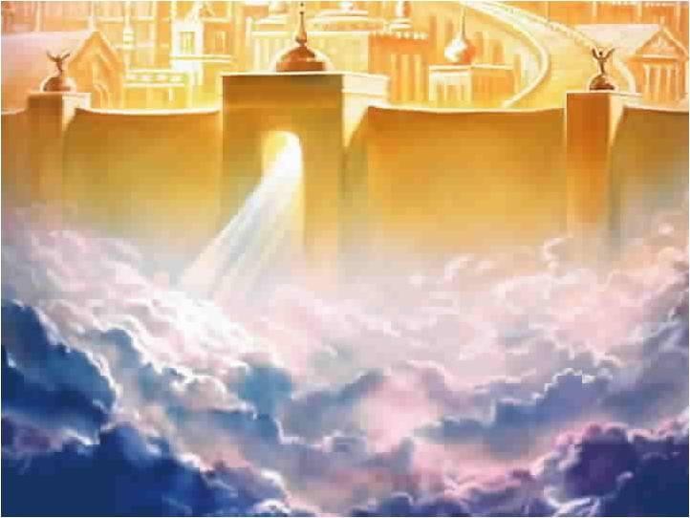
Heaven
and
Hell

Slide 2
Heaven
What is it
Really Like?

Slide 3
The Popular Misunderstanding:
Heaven is the Eternal Home of Believers

Slide 4
Heaven used
Concretely
or
Conceptually

Slide 5
Good Heavens:
There are Three Heavens

Slide 6
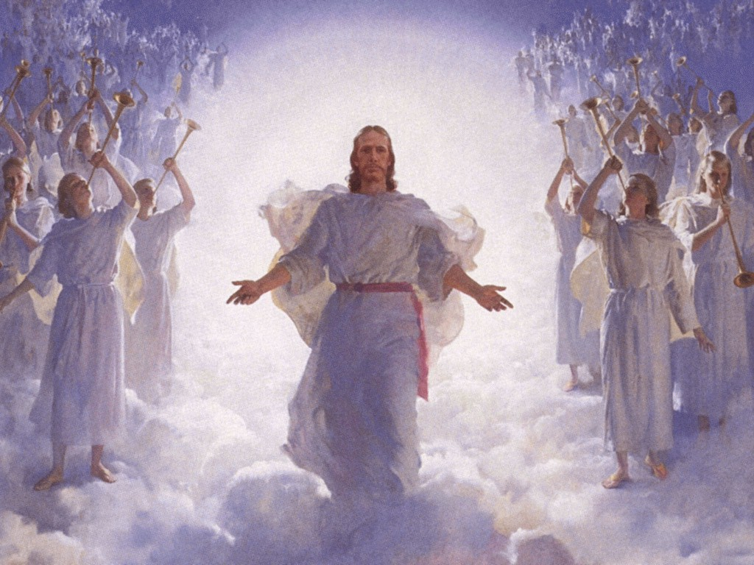
3rd Heaven
Highest Heaven
2nd Heaven
1st Heaven

Slide 7
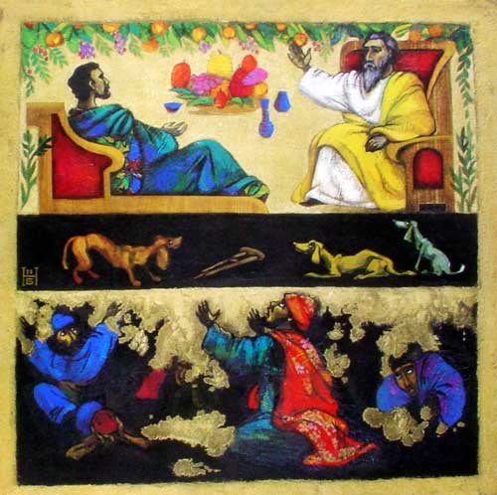
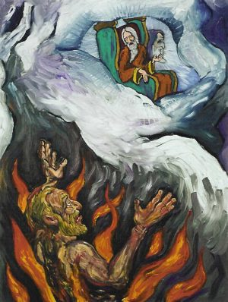

Slide 8
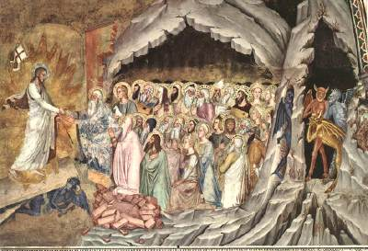

Slide 9
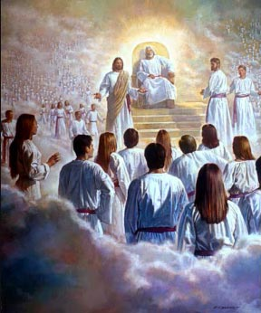
Jesus and Believers

Slide 10
The Eternal Dwelling
of Believers: Earth

Slide 11
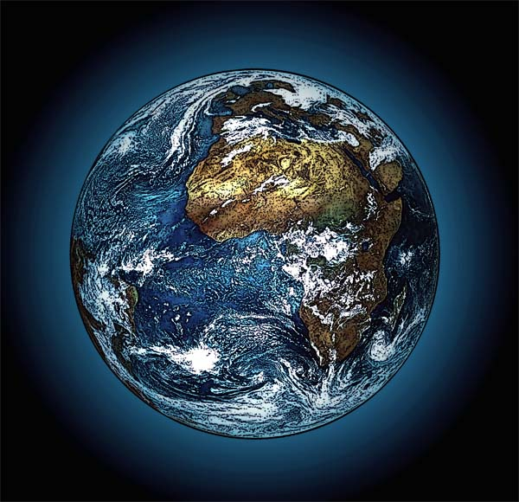
Man was made to dwell on the earth

Slide 13
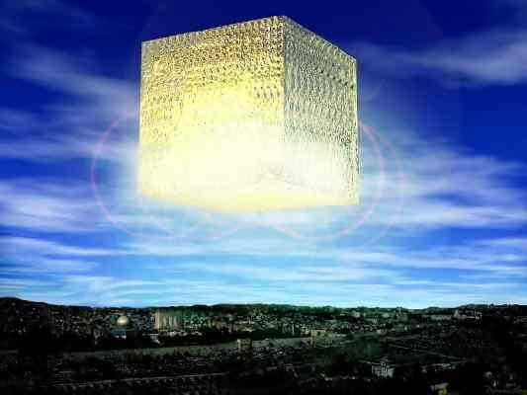

Slide 14
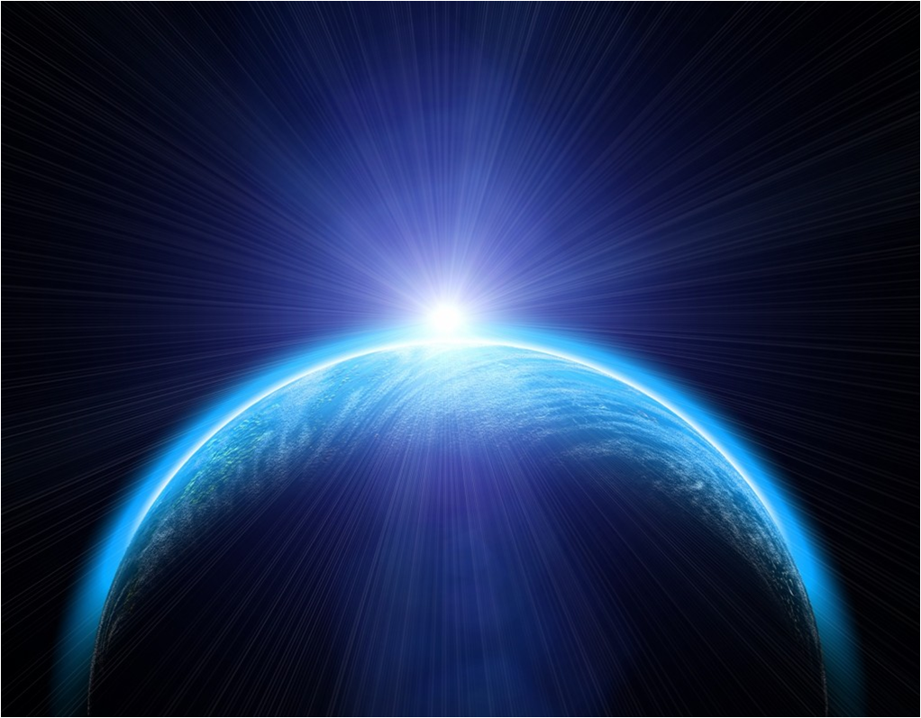
What will the
New Earth be Like?

Slide 15
A Literal Planet
Revelation 21:1

Slide 16
Similar to the Millennial Earth

Slide 17
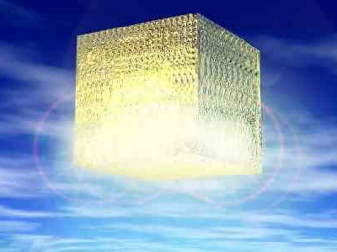
The New Jerusalem

Slide 18
The New Earth -
Cities, Nations, Parks, and Roadways

Slide 19
New Jerusalem -
like the Garden of Eden
Ezekiel 36:35

Slide 20
New Jerusalem -
12 gates made of pearl
Revelation 21:21

Slide 21
New Jerusalem -
Jesus is the Light
Revelation 21:23

Slide 22
New Jerusalem -
Jesus throne
Revelation 21:1

Slide 23
New Jerusalem -
A River
Revelation 21:1-2

Slide 24
The New Earth -
Nations all over the World
Revelation 21:24

Slide 25
The New Earth -
No more Sea
Revelation 21:1

Slide 26
The New Earth -
White Garments
Revelation 3:4-5

Slide 27
The New Earth -
White Stones
Revelation 2:17

Slide 28
The New Earth -
Manna
Revelation 2:17

Slide 29
The New Earth -
Serve for Christ
Revelation 22:3

Slide 30
The New Earth -
Time and Travel?

Slide 31
The New Earth -
No death, Tears, or Pain
Revelation 21:4

Slide 32
The New Earth -
Celebratory Meals
Matthew 22:1-4

Slide 33
The New Earth -
Books Open
Revelation 22:12-13

Slide 34
The New Earth -
Three Groups of People

Slide 35
The New Earth -
Children?

Slide 36
The New Earth -
A Literal, Physical, Tangible Place

Slide 37
Changing the Way we Think about Heaven

Slide 38
“This World is
not My Home”

Slide 39
“This Heaven is
not My Home”

Slide 40
“When We All
Get to Heaven”

Slide 41
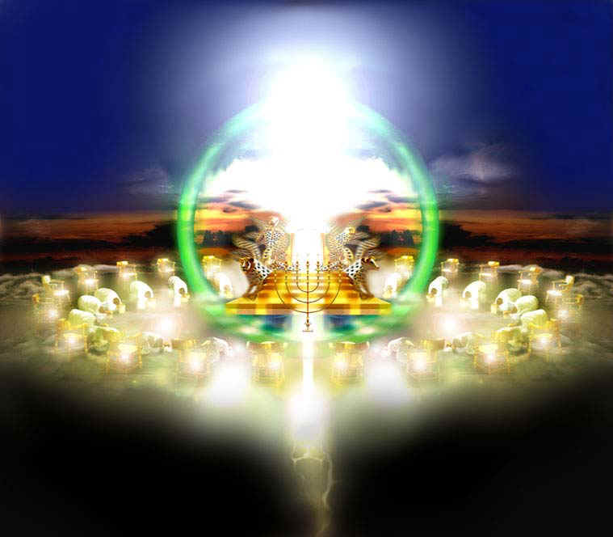

Slide 42
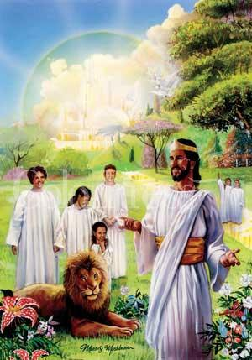
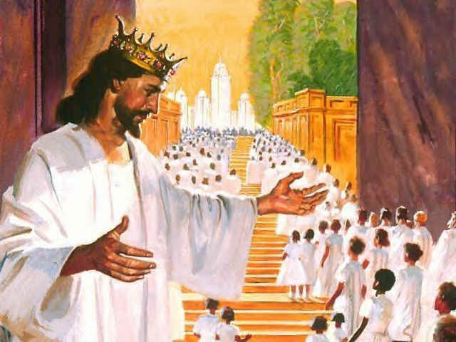

Slide 43
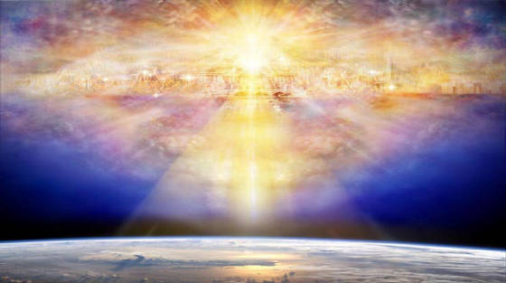

Slide 44
